Slide 1
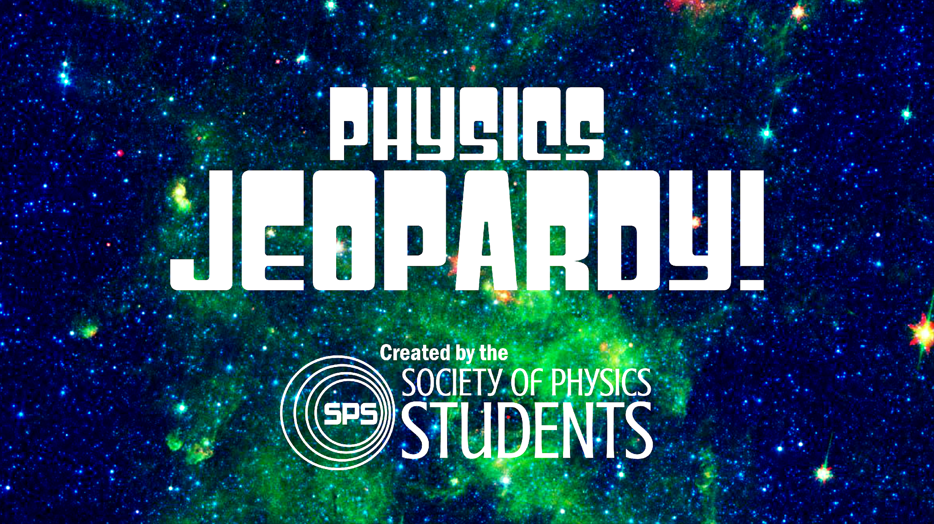
Image Courtesy of NASA

Slide 2
2-D
KINEMATICS
NEWTON
ENERGY AND
MOMENTUM
INTRO TO
QUANTUM
ELECTRICITY
AND
MAGNETISM
LIGHT
100
100
100
100
100
100
200
200
200
200
200
200
300
300
300
300
300
300
400
400
400
400
400
400
500
500
500
500
500
500
FINAL JEOPARDY
Notes:
Click on point values to see questions. Click on “Answer” to view answer, then click “Back” to return to the question board.

Slide 3
2D Kinematics
100
BACK
These mathematical values have a magnitude, but no direction
ANSWER

Slide 4
2D Kinematics
100
What are Scalar Values?
BACK

Slide 5
2D Kinematics
200
BACK
These mathematical objects consist of a magnitude, and a direction
ANSWER

Slide 6
2D Kinematics
200
What are Vectors?
BACK

Slide 7
2D Kinematics
300
BACK
X and Y, I and J
ANSWER

Slide 8
2D Kinematics
300
What are Coordinate Planes?
BACK

Slide 9
2D Kinematics
400
BACK
This vector, commonly used to define a coordinate system, has a direction, with a magnitude of one
ANSWER

Slide 10
2D Kinematics
400
What is a Unit Vector?
BACK

Slide 11
2D Kinematics
500
BACK
While Newtonian Mechanics focuses primarily on the forces in a system, __________ Mechanics focuses on the energy of a system
ANSWER

Slide 12
2D Kinematics
500
What is Hamiltonian?
BACK

Slide 13
Newton
100
BACK
ANSWER

Slide 14
Newton
100
What is Newton’s Second Law?
BACK

Slide 15
Newton
200
BACK
For every force exerted on an object, there is an equal and opposite force on the exerting object
ANSWER

Slide 16
Newton
200
What is Newton’s Third Law?
BACK

Slide 17
Newton
300
BACK
An object’s velocity will remain constant unless the object is acted upon by an outside force
ANSWER

Slide 18
Newton
300
What is Newton’s First Law?
BACK

Slide 19
Newton
400
BACK
ANSWER

Slide 20
Newton
400
What is Newton’s Law of Universal Gravitation?
BACK

Slide 21
Newton
500
BACK
ANSWER

Slide 22
Newton
500
What is Newton’s Second Law (in momentum form)?
BACK

Slide 23
Energy and Momentum
100
BACK
ANSWER

Slide 24
Energy and Momentum
100
What is Gravitational Potential Energy?
BACK

Slide 25
Energy and Momentum
200
BACK
ANSWER

Slide 26
Energy and Momentum
200
What is (Translational) Momentum?
BACK

Slide 27
Energy and Momentum
300
BACK
ANSWER

Slide 28
Energy and Momentum
300
What is Kinetic Energy?
BACK

Slide 29
Energy and Momentum
400
BACK
These two quantities are always conserved in an isolated system
ANSWER

Slide 30
Energy and Momentum
400
What are Energy and Momentum?
BACK

Slide 31
Energy and Momentum
500
BACK
ANSWER

Slide 32
Energy and Momentum
500
What is Angular Momentum?
BACK

Slide 33
Intro to Quantum
100
BACK
This physicist’s equation describes the probability that an electron will be in a given location
ANSWER

Slide 34
Intro to Quantum
100
Who is (Erwin) Schrödinger?
BACK
Notes:
.

Slide 35
Intro to Quantum
200
BACK
It is impossible to know the ________ and the ________ of an electron at the same time
ANSWER

Slide 36
Intro to Quantum
200
What are Position and Momentum?
BACK
Notes:
Theorized by Albert Einstein, general relativity generalizes special relativity and Newton's law of universal gravitation, providing a unified description of gravity as a geometric property of space and time, or spacetime.

Slide 37
Intro to Quantum
300
BACK
The principle that we can’t precisely know the location and the velocity of an electron at the same time
ANSWER

Slide 38
Intro to Quantum
300
What is the Heisenberg Uncertainty Principle?
BACK

Slide 39
Intro to Quantum
400
BACK
Electrons exist in this state until we observe them
ANSWER

Slide 40
Intro to Quantum
400
What is An indeterminate state?
BACK

Slide 41
Intro to Quantum
500
BACK
The intrinsic angular momentum of an electron
ANSWER

Slide 42
Intro to Quantum
500
What is The spin of an electron?
BACK

Slide 43
Electricity and Magnetism
100
BACK
This is created when there is a difference of charge over a distance
ANSWER

Slide 44
Electricity and Magnetism
100
What is An Electric Field?
BACK

Slide 45
Electricity and Magnetism
200
BACK
This group of equations, consisting of the four separate laws, describe the interactions between electric and magnetic fields
ANSWER

Slide 46
Electricity and Magnetism
200
What are Maxwell’s Equations?
BACK

Slide 47
Electricity and Magnetism
300
BACK
Most magnets are examples of magnetic _______
ANSWER

Slide 48
Electricity and Magnetism
300
What are Dipoles?
BACK

Slide 49
Electricity and Magnetism
400
BACK
While electric _________ exist, magnetic _________ have yet to be discovered
(One Answer)
ANSWER

Slide 50
Electricity and Magnetism
400
What are Monopoles?
BACK

Slide 51
Electricity and Magnetism
500
BACK
These two quantities, describing the behavior of electric fields and magnetic fields, are ALWAYS 0
ANSWER

Slide 52
Electricity and Magnetism
500
What are the Curl of an electric field and the Divergence of a magnetic field
BACK

Slide 53
Light
100
BACK
According to Einstein’s Theory of Special Relativity, this value is like a “cosmic speed limit” for the universe
ANSWER

Slide 54
Light
100
What is The Speed of Light in vacuum
BACK

Slide 55
Light
200
BACK
The numerical value for the speed of light
ANSWER

Slide 56
Light
200
What is 2.998 * 10⁸ m/s (or any equivalent)?
BACK

Slide 57
Light
300
BACK
As objects begin to approach the speed of light, they experience time and space differently due to _____________ and _________________
ANSWER

Slide 58
Light
300
What are Time Dilation and Length Contraction?
BACK

Slide 59
Light
400
BACK
This aspect of photons (or light particles) makes them different from every other type of particle in existence (that we know of)
ANSWER

Slide 60
Light
400
What is having no mass?
BACK

Slide 61
Light
500
BACK
This experiment demonstrates one of the most unique qualities of light particles (or photons)
ANSWER

Slide 62
Light
500
What is The Double Slit Experiment? (Particularly the Single-Photon Double Slit Expt)
BACK

Slide 63
FINAL JEOPARDY
TOPIC
BACK
Famous Physicists
QUESTION

Slide 64
FINAL JEOPARDY
QUESTION
BACK
This famous physicist was the first woman to win a Nobel prize, the first person to win the Nobel prize twice, and is the one of the only people to win the Nobel prize in two different fields
ANSWER

Slide 65
FINAL JEOPARDY
ANSWER
Who is Marie Curie?
END

Slide 66
THANK YOU FOR PLAYING
Image Courtesy of NASA

